Slide 1
Data Modelling Session Module-2
Notes:
For information on applying this template to an existing presentations, refer to the notes on slide 2 of this presentation.
The Input area of the Beam can be customised to reflect the content of the presentation. The Input area is an AutoShape with a picture fill. To change this, ensure you have the image you wish to use (ideally a .jpg or a .png file) in an accessible folder. The image should have a ratio of 1:1 to ensure it does not appear distorted. It is not possible to reposition the image within the Input area.
Acceptable images for importing into the Input area of the Beam are the three approved graphics (lines), and black and white photography or illustrations which follow the principles laid out on The Branding Zone. Colour images should never be imported into this area. Please be aware that replacing the Input area with high resolution graphics will significantly increase the file size. Contact your local DDC for assistance with updating the Beam.
Customise the Input area of the Beam as described below.
Click on the View tab from the menu bar and select Master>Slide Master
Right-click on the Input graphic and select Format AutoShape
From the Fill menu, under the Colour and Lines tab, click on the drop-down arrow next to Colour and select the Fill Effects menu
From the Picture tab, click on Select Picture. Navigate to the folder containing the image you wish to insert in the Input area. Highlight the image and tick the Lock picture aspect ratio box. Click on OK
You can now preview the image before continuing. If you are happy with how it looks, click OK to continue. Otherwise, repeat the process until you are happy with your selected image
To exit from Master View, click on View>Normal. The change you made to the Input graphic should now be visible on the title slide.

Slide 2
Introduction
Module-1:
1. Data Modelling Fundamentals - What is it, purpose, etc.
2. The building block of Data Models - Entity, Attributes, Relationship
3. Type of Data Models - Conceptual, Logical, Physical
Module-2:
1. Normalization
2. Relationship & cardinality (1:1, 1:M, M:M)
3. Data Modelling notation
4. Introduction to Dimension Modelling
Module-3:
1. Type of Dimension Models - Star Schema, Snowflake Schema, etc.
2. Different types of Dimensions & fact table
3. Difference between OLTP & OLAP Modeling.

Slide 3
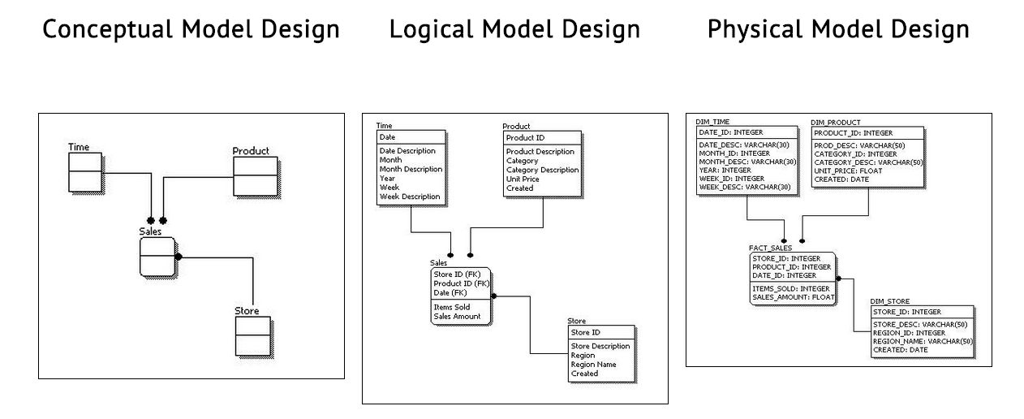
Conceptual, Logical, and Physical Data Models

Slide 4
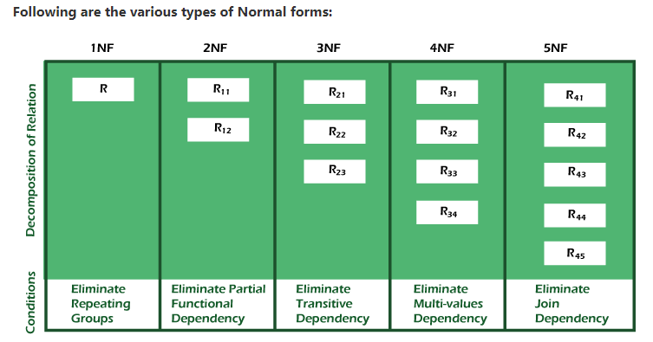
Normalization
Normalization is a process to minimize the redundancy from a relation or set of relations. It is also used to eliminate undesirable characteristics like Insertion, Update, and Deletion Anomalies.
Image Source: https://www.javatpoint.com/dbms-normalization

Slide 5
Normalization Example – 1NF
No attribute hold multiple values. It must hold only single-valued attribute.
Customer Name | Contact Number | Policy Number | Coverage | Amount | Product | Brand
Mr. X | 8884005511 | P100 | PIP,BI,PD | 200,100,150 | Alto | Maruti
Mr.X | 8884005511 | P101 | Full | 550 | Nexon | Tata
Mr.Y | 700556644 | P102 | BI | 100 | Alto | Maruti
1NF
Cust ID | Customer Name | Contact Number | Policy Number | Policy Start Date | Coverage | Amount | Product | Brand
1 | Mr.X | 8884005511 | P100 | 01/01/2022 | PIP | 200 | Alto | Maruti
1 | Mr.X | 8884005511 | P100 | 01/01/2022 | BI | 100 | Alto | Maruti
1 | Mr.X | 8884005511 | P100 | 01/01/2022 | PD | 150 | Alto | Maruti
1 | Mr.X | 8884005511 | P101 | 01/01/2022 | Full | 550 | Nexon | Tata
2 | Mr.Y | 700556644 | P102 | 01/01/2022 | BI | 100 | Alto | Maruti

Slide 6
Normalization Example – 2NF
All non-key attributes are fully functional dependent on the primary key
Cust ID | Customer Name | Contact Number | Policy Number | Coverage | Amount | Product | Brand
1 | Mr.X | 8884005511 | P100 | PIP | 200 | Alto | Maruti
1 | Mr.X | 8884005511 | P100 | BI | 100 | Alto | Maruti
1 | Mr.X | 8884005511 | P100 | PD | 150 | Alto | Maruti
1 | Mr.X | 8884005511 | P101 | Full | 550 | Nexon | Tata
2 | Mr.Y | 700556644 | P102 | BI | 100 | Alto | Maruti
2NF
Cust ID | Customer Name | Contact Number | Policy Number | Cov ID
1 | Mr.X | 8884005511 | P100 | C1
1 | Mr.X | 8884005511 | P100 | C2
1 | Mr.X | 8884005511 | P100 | C3
1 | Mr.X | 8884005511 | P101 | C4
2 | Mr.Y | 700556644 | P102 | C2
Cov ID | Coverage | Amount | Product | Brand
C1 | PIP | 200 | Alto | Maruti
C2 | BI | 100 | Alto | Maruti
C3 | PD | 150 | Alto | Maruti
C4 | Full | 550 | Nexon | Tata
C5 | Full | 550 | Alto | Maruti

Slide 7
Normalization Example – 3NF
No transitive dependency for non-prime attributes, i.e. all columns should be identified only by key.
Cust ID | Customer Name | Contact Number | Policy Number | Cov ID
1 | Mr.X | 8884005511 | P100 | C1
1 | Mr.X | 8884005511 | P100 | C2
1 | Mr.X | 8884005511 | P100 | C3
1 | Mr.X | 8884005511 | P101 | C4
2 | Mr.Y | 700556644 | P102 | C2
Cov ID | Coverage | Amount | Product | Brand
C1 | PIP | 200 | Alto | Maruti
C2 | BI | 100 | Alto | Maruti
C3 | PD | 150 | Alto | Maruti
C4 | Full | 550 | Nexon | Tata
C5 | Full | 550 | Alto | Maruti
3NF
Cust ID | Customer Name | Contact Number | Policy Number | Cov ID
1 | Mr.X | 8884005511 | P100 | C1
1 | Mr.X | 8884005511 | P100 | C2
1 | Mr.X | 8884005511 | P100 | C3
1 | Mr.X | 8884005511 | P101 | C4
2 | Mr.Y | 700556644 | P102 | C2
Cov ID | Coverage | Amount | Product
C1 | PIP | 200 | Alto
C2 | BI | 100 | Alto
C3 | PD | 150 | Alto
C4 | Full | 550 | Nexon
C5 | Full | 550 | Alto
Product | Brand
Alto | Maruti
Nexon | Tata

Slide 8
Normalization Example – 4NF
No multi-valued dependency
Cust ID | Customer Name | Contact Number | Policy Number | Cov ID
1 | Mr.X | 8884005511 | P100 | C1
1 | Mr.X | 8884005511 | P100 | C2
1 | Mr.X | 8884005511 | P100 | C3
1 | Mr.X | 8884005511 | P101 | C4
2 | Mr.Y | 700556644 | P102 | C2
Cov ID | Coverage | Amount | Product
C1 | PIP | 200 | Alto
C2 | BI | 100 | Alto
C3 | PD | 150 | Alto
C4 | Full | 550 | Nexon
C5 | Full | 550 | Alto
Product | Brand
Alto | Maruti
Nexon | Tata
4NF
Cust ID | Customer Name | Contact Number
1 | Mr.X | 8884005511
2 | Mr.Y | 700556644
Cov ID | Coverage | Amount | Product
C1 | PIP | 200 | Alto
C2 | BI | 100 | Alto
C3 | PD | 150 | Alto
C4 | Full | 550 | Nexon
C5 | Full | 550 | Alto
Cust ID | Policy Number | Cov ID
1 | P100 | C1
1 | P100 | C2
1 | P100 | C3
1 | P101 | C4
2 | P102 | C2
Product | Brand
Alto | Maruti
Nexon | Tata

Slide 9
Grain & Cardinality
Cust ID | Customer Name | Contact Number
1 | Mr.X | 8884005511
2 | Mr.Y | 700556644
Coverage ID | Coverage | Amount | Product
C1 | PIP | 200 | Alto
C2 | BI | 100 | Alto
C3 | PD | 150 | Alto
C4 | Full | 550 | Nexon
C5 | Full | 550 | Alto
M:1
1:M
Policy Number | Coverage ID
P100 | C1
P100 | C2
P100 | C3
P101 | C4
P102 | C2
Product | Brand
Alto | Maruti
Nexon | Tata
Policy Number | Cust ID | Policy Start Date
P100 | 1 | 01/01/2022
P101 | 1 | 01/01/2022
P102 | 2 | 01/01/2022
One record for each Product
One record for each Cust ID
One record for each Policy & Coverage combination
One record for each Policy

Slide 10
Data Modelling Notation
The cardinality of a join between two tables is the numerical relationship between rows of one table and rows in the other.
Relationship | Example | Left | Right | Narrative
One-to-one | Driver ←→ Driving License | 1 | 1 | A Driver must have their driving license
One-to-one (optional on one side) | Driver ←→ International Driving License | 1 | 0..1 or ? | A Driver may have internation permit
Many-to-one | Driver ←→ Location | 1..* or + | 1 | Many people/drivers can be from the same place
Many-to-many (optional on both sides) | Driver ←→ Traffic Rule Violation | 0..* or * | 0..* or * | A Driver may or may not violated traffic rules
One-to-many | Policy ←→ Coverage | 1 | 1..* or + | A policy contains at least one coverage
Many-to-many | Driver ←→ Vehicle | 1..* or + | 1..* or + | Driver drives various vehicle

Slide 11
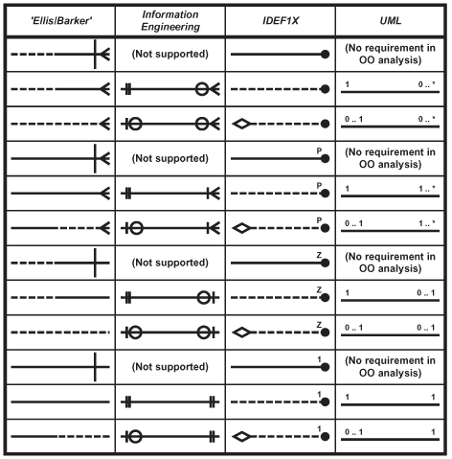
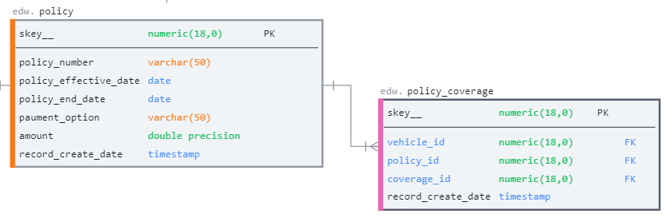
Data Modelling Notation
Ellis–Barker
Information Engineering
IDEF1X
UML notations
Information Engineering

Slide 12
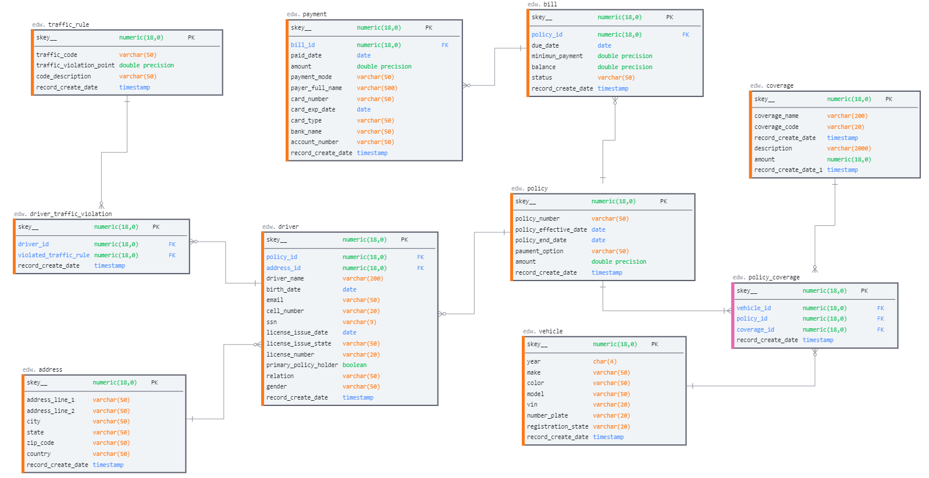
Relational Model - Example
Normalized Model:

Slide 13
Dimensional Modeling
A denormalized relational model
Made up of tables with attributes
Relationships defined by keys and foreign keys
Organized for understandability and ease of reporting rather than update
Queried and maintained by SQL or special purpose management tools.
Entity-Relationship vs. Dimensional Models
One table per entity
Minimize data redundancy
Optimize data write
The transaction Processing Model
One fact table for subject area
Maximize understandability & ease of use
Optimized for retrieval
The data warehousing model

Slide 14
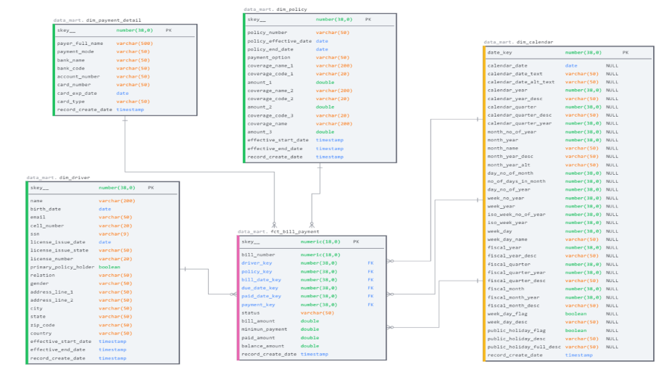
Dimensional Model – Star Schema
Star Schema Model:

Slide 15
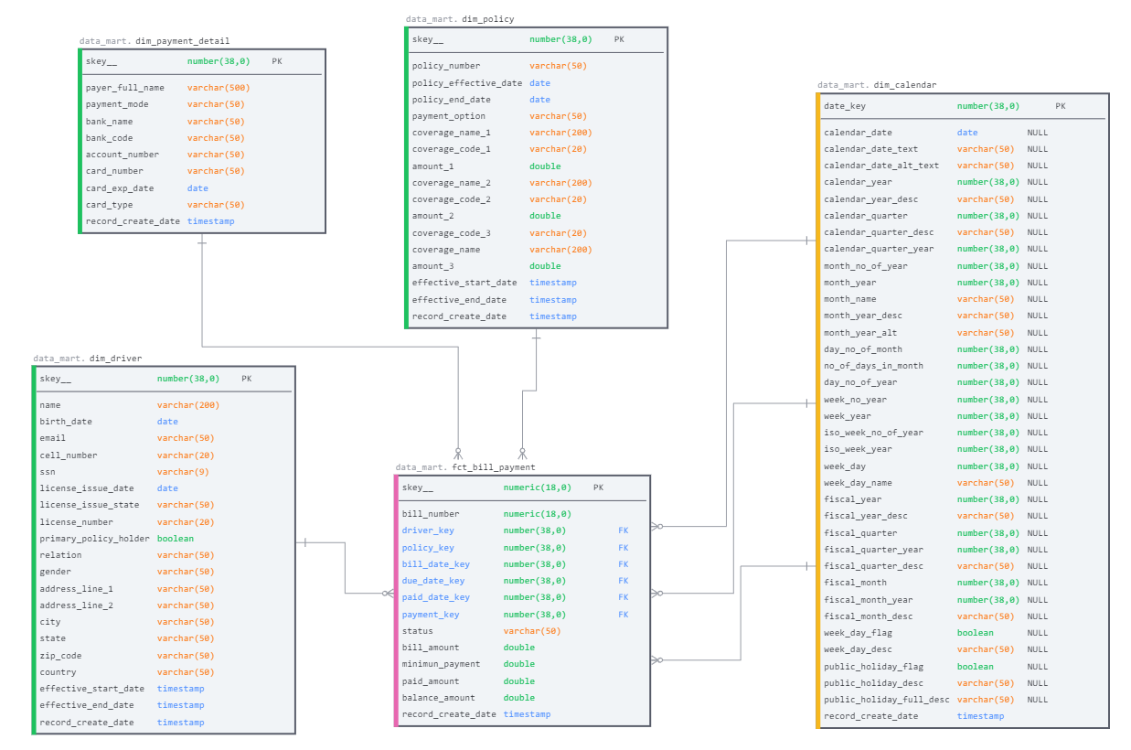

Slide 16
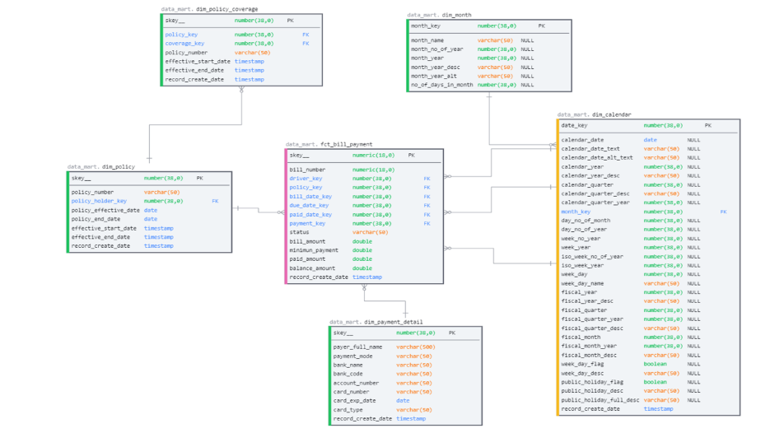
Dimensional Model – Snowflake Schema
Star Schema Model:

Slide 17
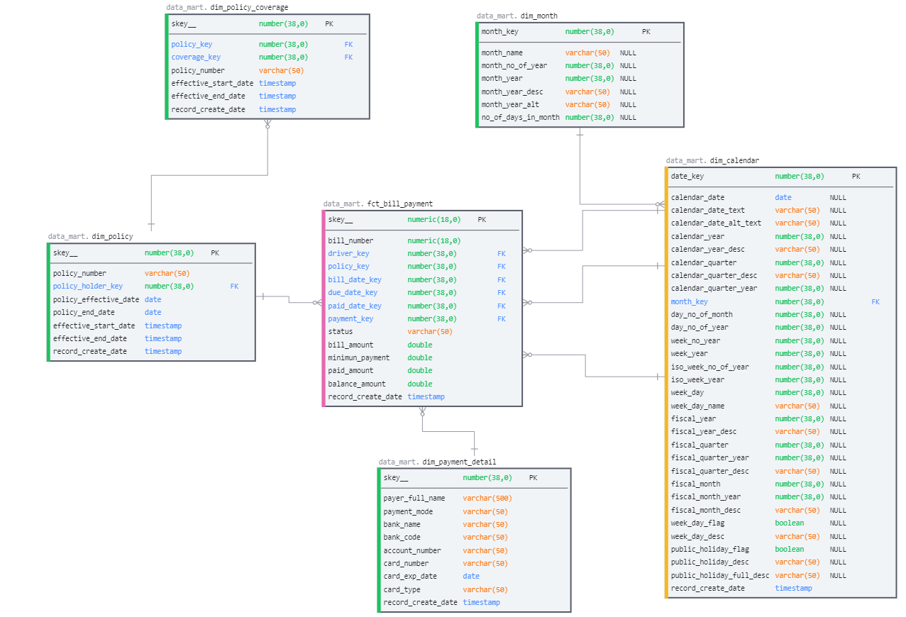

Slide 18
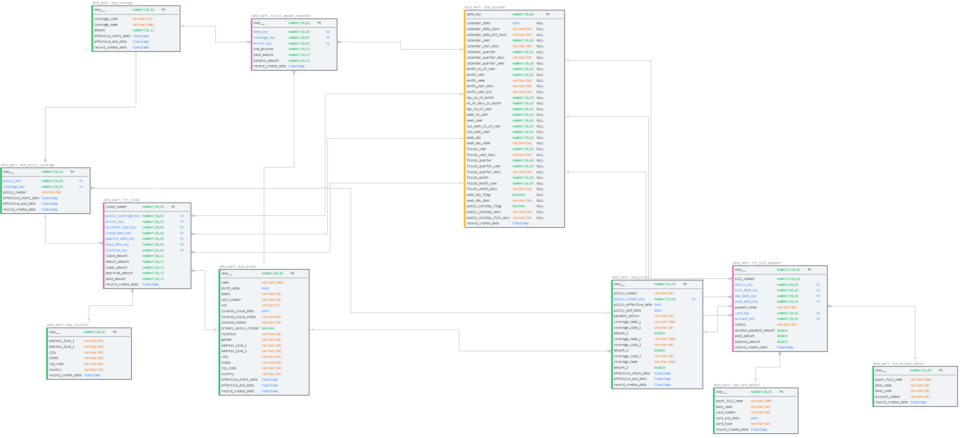
Dimensional Model – Galaxy Schema

Slide 19
Thank You

Slide 20
Appendix – Data Model
3NF Model:
Star Schema Model:
Galaxy Schema Model:

